Slide 1


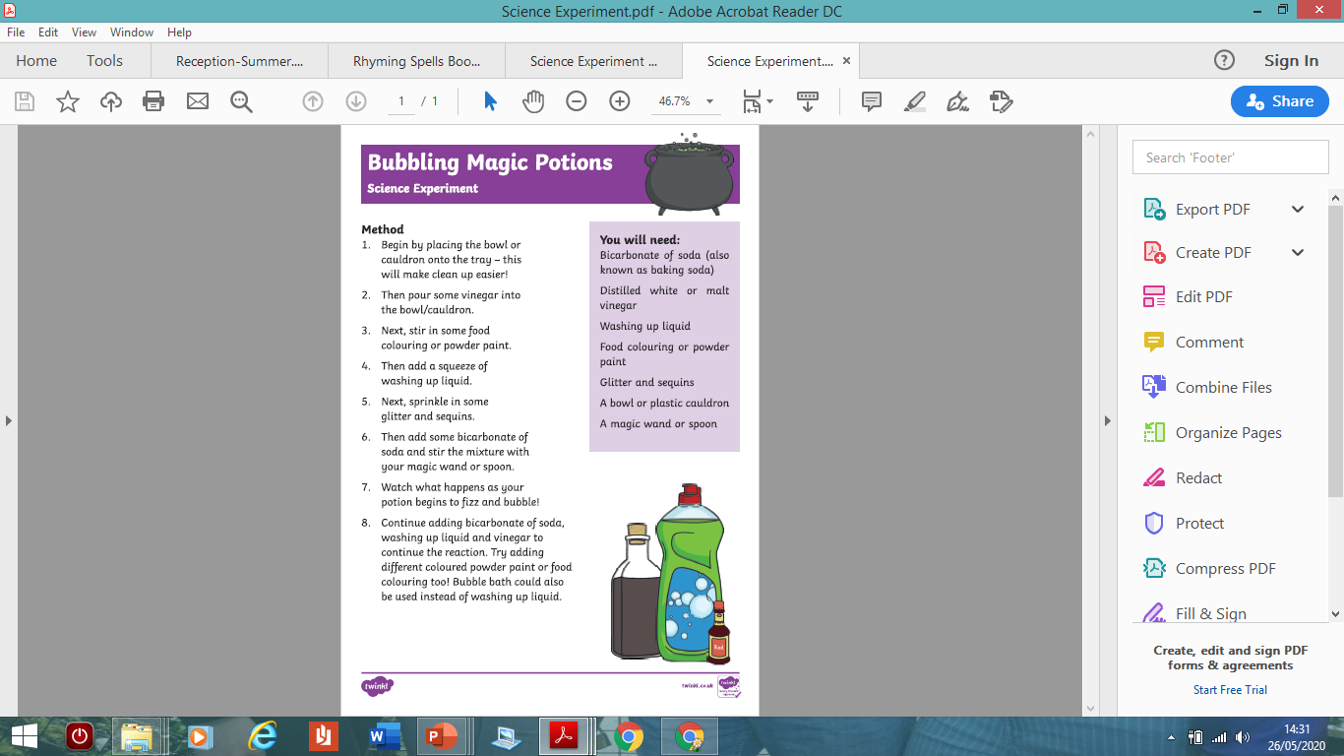
Useful websites:
www.topmarks.co.uk www.bbc.co.uk/cbeebies
www.ictgames.com www.phonicsplay.co.uk
www.cosmicyoga.co.uk
www.oxfordowl.co.uk (lots of our reading books are on here)
Peek at the week
Maple and Cherry Class
WB - 29.06.20
Here we go again with another week of fun learning.
Following on from Knights and dragons this week we are exploring Witches and Frogs!
Remember we love seeing your work so please keep sending it via - info@bagshot.surrey.sch.uk
Love Mrs Putman and Mrs Evans
Understanding the world
Can you have a go at a bit of science? Please make sure you get a grown up to help you.
What happens and what colours can you see?
Reading
Read for 10 -15 minutes everyday.
Try Oxford Owl or a book from home – can you find a fun place to read and take a picture? https://www.oxfordowl.co.uk/for-home/find-a-book/library-page
Find out about Saint George and the dragon -
https://www.youtube.com/watch?v=3YuVzOK89EA
Read or listen to ‘A Brave Knight’ and can you answer the questions?
https://www.youtube.com/watch?v=qn8RDDb7CDA
Find out castles by having a look at some Usborne books https://www.youtube.com/watch?v=ZNLcKoUeaio&t=264s

Slide 2

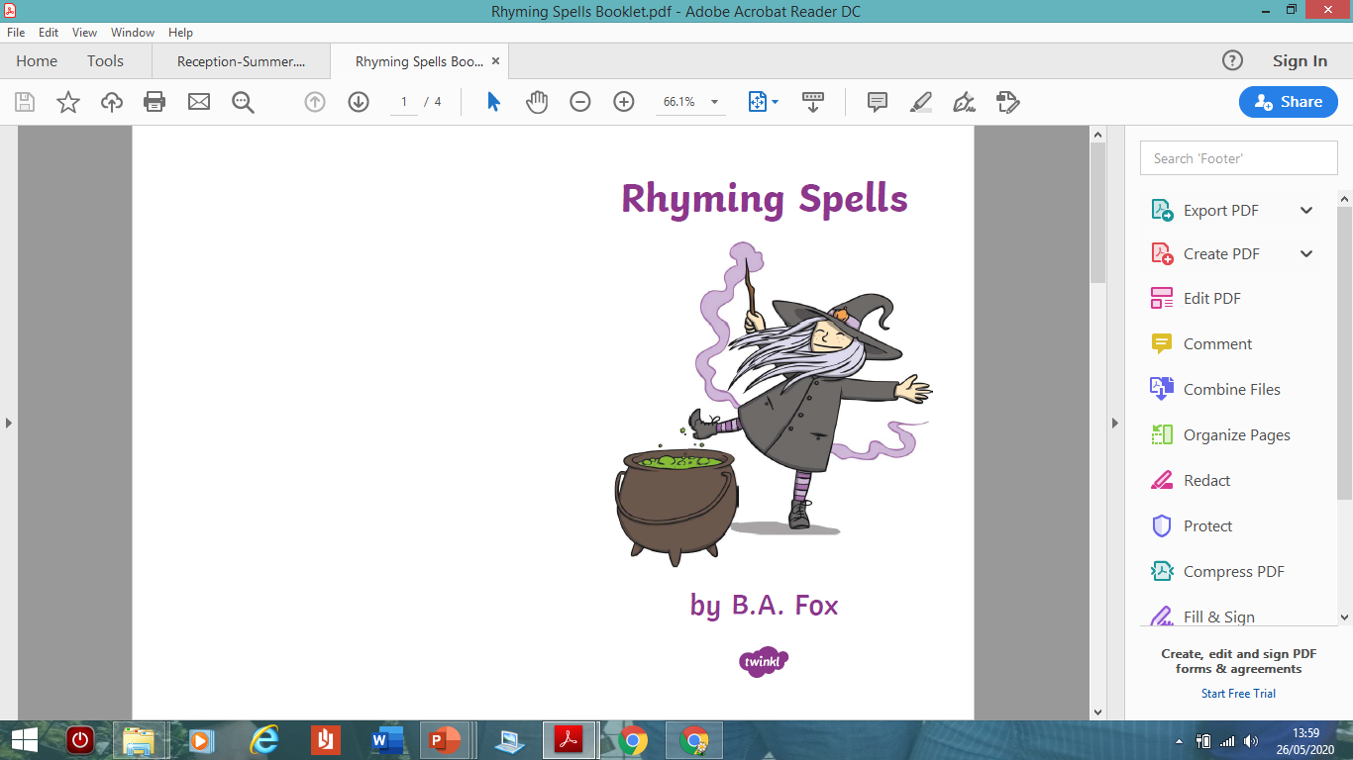
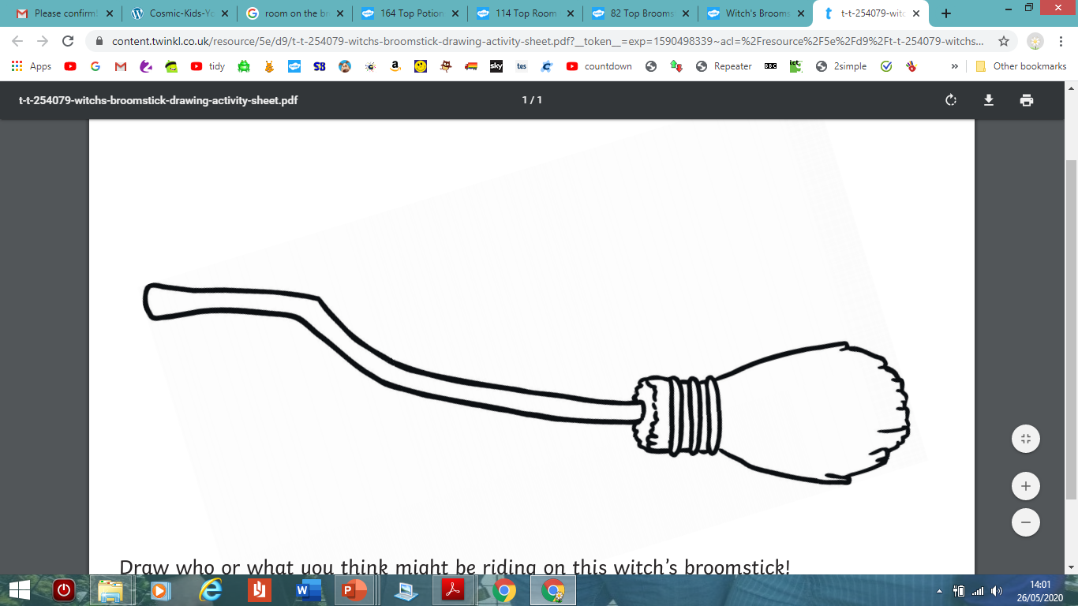
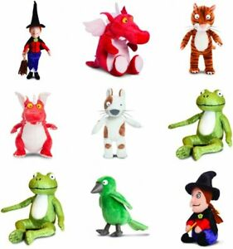
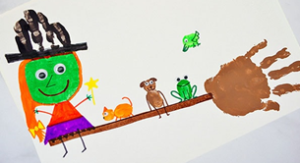
Literacy/Topic – Julia Donaldson Stories
Last week we read the story of ‘Zog’. This week we are going to look at the story of ‘Room on the Broom’ by Julia Donaldson (she even has her own website https://www.juliadonaldson.co.uk/)
Listen to and watch the story - https://www.youtube.com/watch?v=XRany_OScms
Design a new and improved broom for the witch and her friends. Draw a picture of it and label its key features
Create a magic spell for the witch to
say as mixes the potion for her new broom
A terrible beast protects the witch from the dragon at the end of the story. Who is the terrible beast and how does it save the witch? Was it such a ‘terrible’ beast after all? Tell a grown up what you think and why.
Where do you think the witch and friends should travel next on the broom? What could be their next adventure together? Write about what it could be and draw a picture to go with it.
If you can get outside and are able to use
paint perhaps you can hand print your own
witch and broom

Slide 3

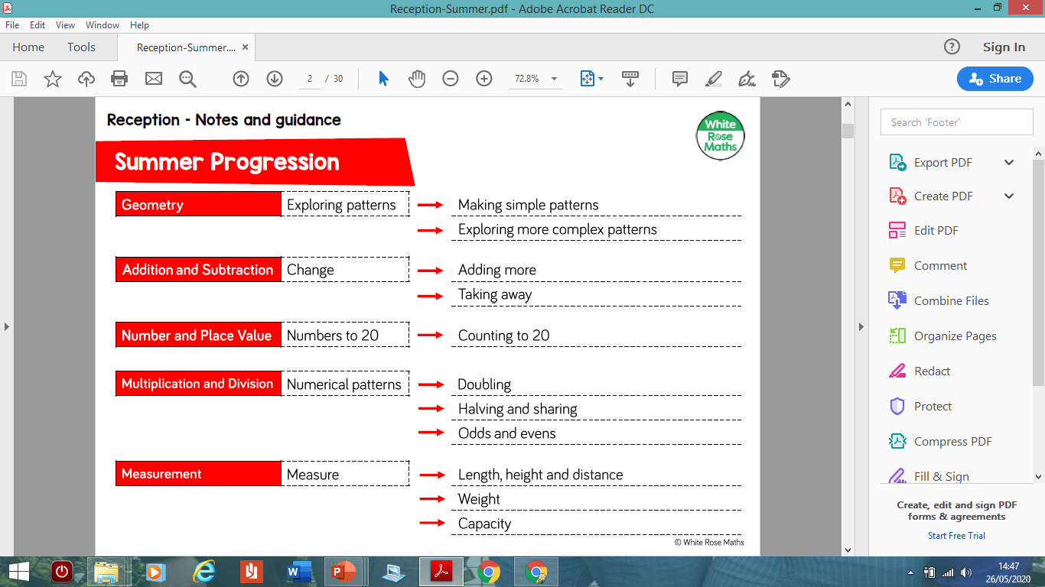


Maths
White Rose Maths:
https://wrm-13b48.kxcdn.com/wp-content/uploads/2019/12/Reception-Summer.pdf
This weeks focus is Doubling – pages 17 & 18
Find out about a pair of twins in the story of Alison Hubble –
https://www.youtube.com/watch?v=3BjX68jX6Wg
Numberblocks get up to mischief in ‘Double Trouble’ –
https://www.bbc.co.uk/iplayer/episode/b08q4jkq/numberblocks-series-2-double-trouble
Have a go with some dice
Games and see how many
times you can roll a double
Can you keep score and
find out who in your family
gets the most number of
doubles?
Stay Active
Cosmic Kids – yoga, try ‘Ruby Broom’
https://www.youtube.com/watch?v=ArOzn2dtDdA
Cosmic Kids – yoga all finding new things to do, try ‘Stezzi the parrot’
https://www.youtube.com/watch?v=LIBz0IdOFiQ
Don’t forget to check out the great Joe Wicks for some daily PE too
Phonics
Over the next few weeks we are suggesting making phonics comics https://phonicsplaycomics.co.uk/comics.html
We really hope you are enjoying making comics with you phonics, don’t forget to challenge yourself and have a go with a different set of phonics each week.
Also don’t forget to also use your Reading
Eggs log ins to access lot of other phonics
games and activities
Playing and Exploring
Playing including open ended play, is a very important part of the Early Years curriculum. It encourages imagination, role play, enquiry and investigation, problem solving, independence, and creativity. We very much encourage play to be part of each day. What will you choose each day?

