Slide 1

How to support your child in Mathematics.

Slide 2
Pattern in the nursery
Althouse (1994) describes how, when making body movement patterns, most four year olds could describe a three word body sequence, such as touching head-eyes-shoulders, head-eyes-shoulders...; and she found that some five year olds could teach others five- and six-word body sequences. She also noted that when children ‘understood “what comes next” in relationship to “what came before” they had no difficulty understanding and making patterns’.
Montague-Smith, A. (2002), Mathematics in Nursery Education (2nd Ed), London: David Fulton

Slide 3
Numbers and Patterns
It is vital to lay secure foundations in early mathematics (educate, enable, enrich, enjoy).
Children need to engage with numbers and to see how to use them in their everyday environment for labelling, quantifying and calculating: we want to help them to develop a better understanding of the world in which they live.

Slide 4
Numbers and patterns
‘Virtually all mathematics is based on pattern and structure’
Mulligan, J. & Mitchelmore, M. (2009), “Awareness of Pattern and Structure in Early Mathematical Development”, Mathematics Education Research Journal, 21 (2), pp 33-49
Counting is a significant aspect of children’s early understanding of number and is the foundation on which quantifying and calculating are built.

Slide 5
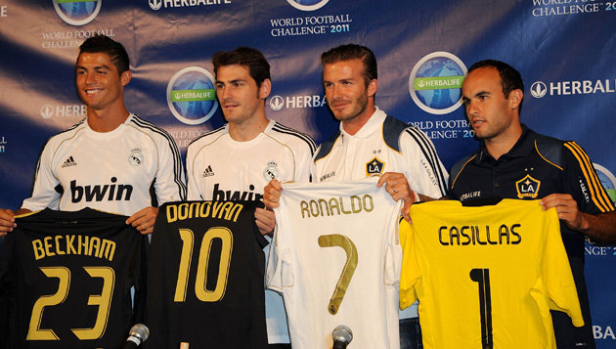
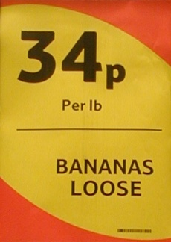
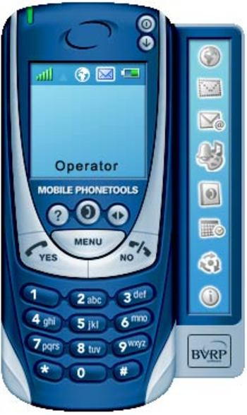
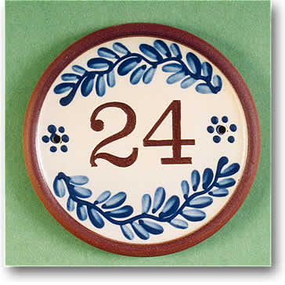
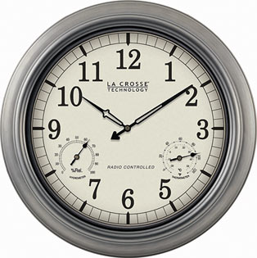
Number words and numerals
This focuses on the development of children’s awareness, understanding and use of the language of number.

Slide 6
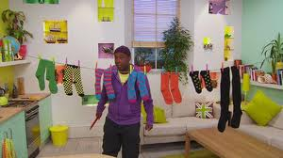
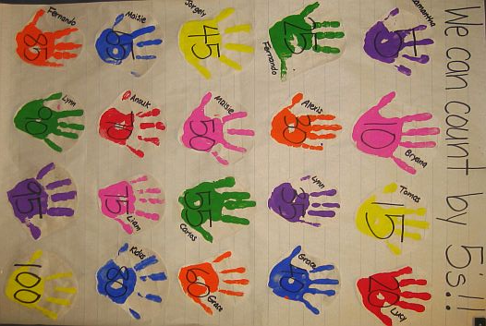
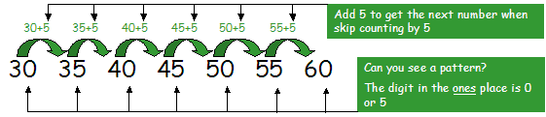
Number words and numerals
Extend the range of numbers that children can confidently use.
Children can also start to explore the sequences of numbers when they count from zero in twos, fives and tens
Notes:
Show a simple numberline to count in 2s. Demonstrate how to recognise odd and even

Slide 7
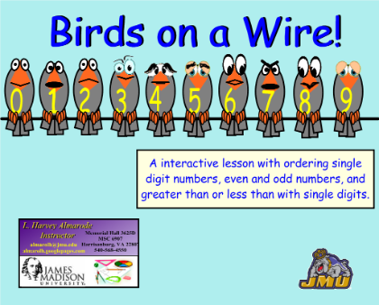
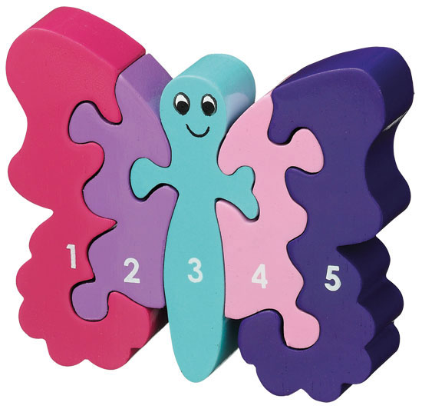
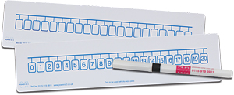
Number words and numerals
Recognition of numbers and number words, matching the two together and ordering numerals.

Slide 8
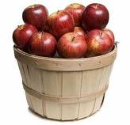
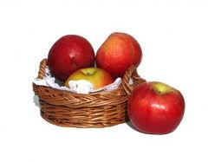
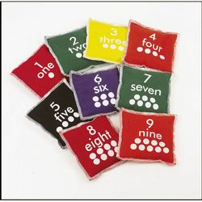
Counting sets
Focusing on the development of children’s early awareness of quantity.
more
less
Counting doesn’t have to be objects, it can also be actions or sounds.

Slide 9
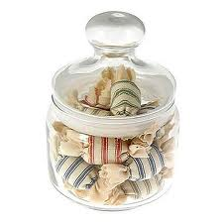
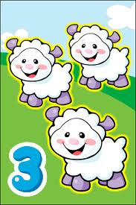
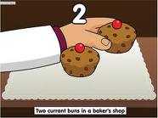
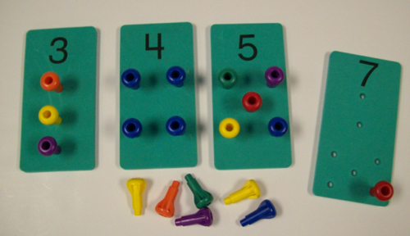
Counting sets
The development of children’s ability to count objects and to recognise, without counting, small sets of objects.
Add to sets and take away from sets, asking ‘how many now?’.
Later stage, estimating large amounts of objects and learning to count large amounts by ‘checking them off’ as they go.

Slide 10
Keep maths practical and have fun!
  Bath-time (filling and emptying containers, counting)
  Counting rhymes
  Talk about numbers in the environment (eg, front door numbers, number plates, road signs etc)
  Help with the cooking (measuring, weighing, ordering the recipe)
  Setting table places (how many plates/cups etc)
  Paying in shops (including change)
  Estimating amounts (how many apples/sweets?)

Slide 11
MATHS ZONE
http://www.surreyheathmathszone.co.uk/

